Slide 1

Subject Name : Data Structures and Algorithms
Subject Code : 22CSE108
Total Contact Hours : 45
Credits : 03 L-T-P : 1-1-2
FACULTY OF
ENGINEERING
AND TECHNOLOGY

Slide 2
Module - 4
Sorting and Searching
FACULTY OF
ENGINEERING
AND TECHNOLOGY

Slide 3
Sorting
Sorting is an algorithm that arranges the elements of a list in a certain order.
Ascending order or descending order.
The output is a permutation or reordering of the input.
Sorting is one of the important categories of algorithms in computer science.
Sometimes sorting significantly reduces the complexity(time/space) of the problem.
We can use sorting as a technique to reduce the search complexity.
Sorting algorithms are classified into different categories based on the following parameters.
FACULTY OF
ENGINEERING
AND TECHNOLOGY

Slide 4
Sorting
By number of comparisons
By number of swaps
By memory usage
By recursion
By stability
By adaptability
Internal and external sorting
By number of comparisons
In this method, sorting algorithms are classified based on the number of comparisons.
For comparison based algorithms the best case behavior is O(nlogn) and the worst case behavior is O(n²)
Comparison based algorithms evaluate the elements of the list by key comparison operation and needs at least O(nlogn) comparisons for most inputs.
FACULTY OF
ENGINEERING
AND TECHNOLOGY

Slide 5
Sorting
By number of swaps
In this method, sorting algorithms are categorized by number of swaps.
Also called inversions.
By memory usage
Some sorting algorithms are “ in place” and they need O(1) or O(logn) memory to create auxillary locations for sorting the data temporarily.
By recursion
Sorting algorithms are
Recursive
Example: Quick sort
non-recursive
Example: Bubble sort, Selection sort, Insertion sort.
FACULTY OF
ENGINEERING
AND TECHNOLOGY

Slide 6
Sorting
There are some algorithms which uses both
Example: Merge sort.
Internal sort and External Sort
Internal sort
Sort algorithms which use main memory exclusively during the sort are called internal sorting algorithms.
This kind of algorithms assumes high speed random access to all memory.
External Sort
Sorting algorithms which uses external memory, such as tape or disk, during the sorting comes under external sort.
FACULTY OF
ENGINEERING
AND TECHNOLOGY

Slide 7
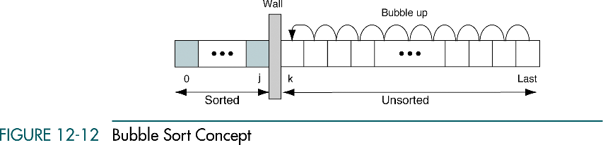
Bubble Sort
Example for n² sort
It is an Exchange sort.
In exchange sort we exchange elements that are out of order until the entire list is sorted.
FACULTY OF
ENGINEERING
AND TECHNOLOGY

Slide 8
Bubble Sort
In the bubble sort, the list at any moment is divided into two sub-lists
sorted
unsorted
The smallest element is bubbled from the unsorted sub-list and moved to the sorted sub-list
After moving the smallest to the sorted list, the wall moves one element to the right by
increasing the number of sorted elements
Decreasing the number of unsorted ones.
Each time an element moves from the unsorted sub-list to sorted sub-list, one sort pass is completed.
Given a list of n elements , the bubble sort requires up to n-1 passes to sort the data
FACULTY OF
ENGINEERING
AND TECHNOLOGY

Slide 9
Bubble Sort Algorithm
BubbleSort(A,n)
Current = 0
While ( Current ≤ n-2 )
Walk = n-1
While (Walk > Current)
If ( A[Walk] < A[Walk -1) then
Exchange A[Walk] and A[Walk-1]
EndIf
Decrement Walk
EndWhile
Increment Current
EndWhile
Stop
Time Complexity of Bubble Sort is O(n²)
BubbleSort(A,n) {
for ( current=0; current <= n-2; current++) {
for (walk= n-1; walk > current; walk--) {
if(A[walk]<A[walk-1]) {
temp=A[walk];
A[walk]= A[walk-1];
A[walk-1]= temp;
}
}
}
}
FACULTY OF
ENGINEERING
AND TECHNOLOGY

Slide 10
Bubble Sort Analysis
When Current=0 then Walk=n-1,n-2,n-3,….,2,1
There are n-1 values for Walk
When Current=1 then Walk=n-1,n-2,n-3,….,3,2
There are n-2 values for Walk
When Current=2 then Walk=n-1,n-2,n-3,….,4,3
There are n-3 values for Walk
When Current=n-2 then Walk=n-1
There is only 1 value for Walk
So the comparison A[Walk]< A[Walk-1] will take place (n-1)+(n-2)+(n-3)+…+1 = (n-1)(n)/2 = O(n²) times.
FACULTY OF
ENGINEERING
AND TECHNOLOGY

Slide 11
Bubble Sort Example
Sort the Array:
25 | 5 | 15 | -45 | 100
N=5
Pass 1: current=0
Walk= 4
25 | 5 | 15 | -45 | 100
Walk= 3
25 | 5 | 15 | -45 | 100
Walk= 2
25 | 5 | -45 | 15 | 100
Walk= 1
25 | -45 | 5 | 15 | 100
-45 | 25 | 5 | 15 | 100
After Pass1

Slide 12
Bubble Sort Example
After Pass1
-45 | 25 | 5 | 15 | 100
Pass 2: current=1
Walk= 4
-45 | 25 | 5 | 15 | 100
Walk= 3
-45 | 25 | 5 | 15 | 100
Walk= 2
-45 | 25 | 5 | 15 | 100
-45 | 5 | 25 | 15 | 100
After Pass2

Slide 13
Bubble Sort Example
After Pass2
-45 | 5 | 25 | 15 | 100
Pass 3: current=2
-45 | 5 | 25 | 15 | 100
Walk= 4
Walk= 3
-45 | 5 | 25 | 15 | 100
-45 | 5 | 15 | 25 | 100
After Pass3
Pass 4: current=3
Walk= 4
-45 | 5 | 15 | 25 | 100
-45 | 5 | 15 | 25 | 100
Sorted Array

Slide 14
Selecion Sort
Example for n² sort
It is an in-place sorting algorithm.
Requires no additional memory : O(1)
Selection sort works well for small files
It is used for sorting the files with large values and small keys.
Selection is made based on keys and swaps are made only when required.

Slide 15
Selection Sort Concept
In the selection sort, the list at any moment is divided into two sub-lists
Sorted
Unsorted divided by an imaginary wall.
The smallest element from the unsorted sub-list is selected and exchange it with the element at the beginning of the unsorted sub-list
After each selection and exchange, the wall moves one element to the right by
increasing the number of sorted elements
Decreasing the number of unsorted ones.
Each time one element moves from the unsorted sub-list to sorted sub-list, one sort pass is completed.
Given a list of n elements , the selection sort need n-1 passes to sort the data completely.

Slide 16
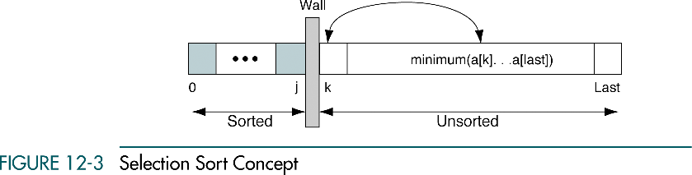
Selecion Sort Concept

Slide 17
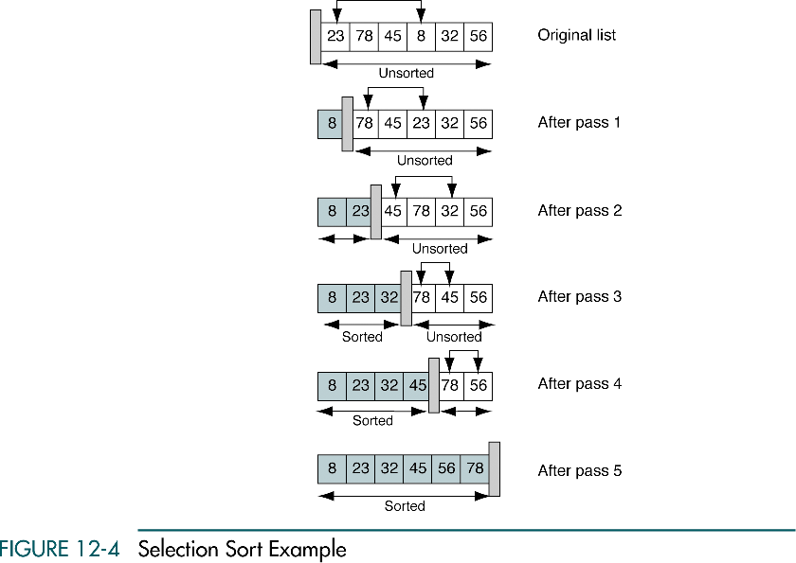
Selecion Sort Example

Slide 18
Selection Sort Algorithm
SelectionSort(A,n)
Current = 0
While ( Current ≤ n-2 )
Small = Current
Walk = Current +1
While (Walk ≤ n-1)
If ( A[Walk] < A[Small]) then
Small = Walk
EndIf
Increment Walk
EndWhile
Exchange A[Current] and A[Small]
Increment Current
EndWhile
Stop
Time Complexity of Selecion Sort is O(n²)
SelectionSort(A,n) {
for ( current=0; current <= n-2; current++) {
small = current;
for (walk= current+1; walk <= n-1; walk++) {
if(A[walk]<A[small])
small = walk;
}
temp=A[current];
A[current]= A[small];
A[small]= temp;
}
}

Slide 19
Selection Sort Analysis
When Current=0 then Walk=1,2,3,…..,n-1
There are n-1 values for Walk
When Current=1 then Walk=2,3,4,….,n-1
There are n-2 values for Walk
When Current=2 then Walk=3,4,….,n-1
There are n-3 values for Walk
When Current=n-2 then Walk= n-1
There is only 1 value for Walk
So the comparison A[walk]< A[small] will take place (n-1)+(n-2)+(n-3)+…+1 = (n-1)(n)/2 = O(n²) times.

Slide 20
Selection Sort Example
Sort the Array:
25 | 5 | 15 | -45 | 100
N=5
Pass 1: current=0
Small= 0
Walk= 1
5 < 25
Small= 1
Walk= 2
15 < 5
Small= 1
-45 < 5
Small= 3
Walk= 3
Walk= 4
100 < -45
Small= 3
-45 | 5 | 15 | 25 | 100
After Pass1

Slide 21
Selection Sort Example
-45 | 5 | 15 | 25 | 100
After Pass1
Pass 2: current=1
Small= 1
Walk= 2
15 < 5
Small= 1
25 < 5
Small= 1
Walk= 3
Walk= 4
100 < 5
Small= 1
-45 | 5 | 15 | 25 | 100
After Pass2

Slide 22
Selection Sort Example
-45 | 5 | 15 | 25 | 100
After Pass2
Pass 3: current=2
Small= 2
25 < 15
Small= 1
Walk= 3
Walk= 4
100 < 15
Small= 1
-45 | 5 | 15 | 25 | 100
After Pass3

Slide 23
Selection Sort Example
-45 | 5 | 15 | 25 | 100
After Pass3
Pass 4: current=3
Small= 3
Walk= 4
100 < 25
Small= 1
-45 | 5 | 15 | 25 | 100
After Pass4
Sorted Array
-45 | 5 | 15 | 25 | 100

Slide 24
Insertion Sort
Example for n² sort
Simple and efficient comparison sort
Most common sorting technique used by card players.
Advantages:
Simple implementation
Efficient for small data
Adaptive: if the input list is presorted(may not be completely) then insertion sort takes O(n + d) time
Number of inversions : d
Stable: Maintains relative order of input data if the keys are same.
In-place: It requires only a constant amount O(1) of additional memory space
Online: Insertion sort can sort the list as it receives it.

Slide 25
Insertion Sort Concept
In the insertion sort, the list at any moment is divided into two sub-lists
Sorted
Unsorted divided by an imaginary wall.
Initially, first element of the list is the only element in the sorted sublist
Each time one element moves from the unsorted sub-list to sorted sub-list, one sort pass is completed.
In each pass, the first element of unsorted sublist is transferred to the sorted sublist by inserting it at the appropriate place
After each pass, the wall moves one element to the right by
increasing the number of sorted elements
Decreasing the number of unsorted ones.
Given a list of n elements , the insertion sort take at most n-1 passes to sort the data completely.

Slide 26
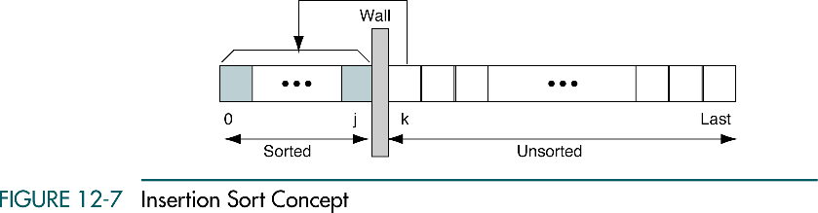
Insertion Sort Concept

Slide 27
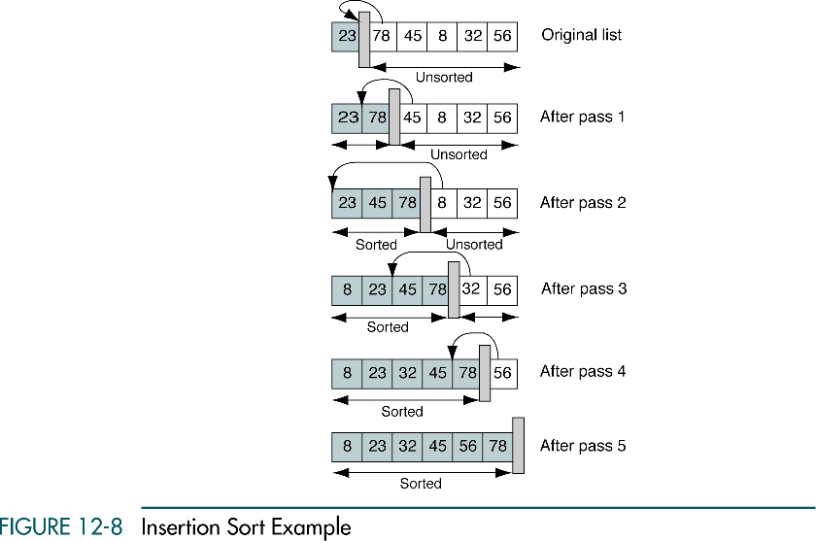
Insertion Sort Example

Slide 28
Insertion Sort Algorithm
InsertionSort(A,n)
Current = 1
While ( Current ≤ n-1 )
ele = A[Current]
Walk = Current -1
While (Walk ≥ 0 AND ele< A[Walk])
A[Walk+1] = A[Walk]
Decrement Walk
EndWhile
A[Walk+1] = A[Walk]
Increment Current
EndWhile
Stop
Worst case Time Complexity of Insertion Sort is O(n²)
InsertionSort(A,n) {
for ( current=1; current <= n-1; current++) {
ele = A[current];
for (walk= current-1; walk ≥ 0 && ele< A[Walk] ; walk--) {
A[Walk+1] = A[Walk];
}
A[Walk+1] = A[Walk];
}
}

Slide 29
Insertion Sort Example
Sort the Array:
25 | 5 | 15 | -45 | 100
N=5
Pass 1: current=1
ele= 5
Walk= 0
5 < 25
5 | 25 | 15 | -45 | 100
5 | 25 | 15 | -45 | 100
After Pass1

Slide 30
Insertion Sort Example
5 | 25 | 15 | -45 | 100
After Pass1
Pass 2: current=2
ele= 15
Walk= 1
15 < 25
5 | 25 | 25 | -45 | 100
Walk= 0
15 < 5
5 | 15 | 25 | -45 | 100
5 | 15 | 25 | -45 | 100
After Pass2

Slide 31
Insertion Sort Example
5 | 15 | 25 | -45 | 100
After Pass2
Pass 3: current=3
ele= -45
Walk= 2
-45 < 25
5 | 15 | 25 | 25 | 100
Walk= 1
-45 < 15
5 | 15 | 15 | 25 | 100
Walk= 0
-45 < 5
5 | 5 | 15 | 25 | 100
-45 | 5 | 15 | 25 | 100
After Pass3

Slide 32
Insertion Sort Example
-45 | 5 | 15 | 25 | 100
After Pass3
Pass 4: current=4
ele= 100
Walk= 2
100 < 25
-45 | 5 | 15 | 25 | 100
-45 | 5 | 15 | 25 | 100
After Pass4
Sorted Array

Slide 33
Merge Sort
Divide and Conquer cuts the problem in half each time, but uses the result of both halves:
cut the problem in half until the problem is trivial
solve for both halves
combine the solutions
Divide the unsorted array into 2 halves until the sub-arrays only contain one element
Merge the sub-problem solutions together:
Compare the sub-array’s first elements
Remove the smallest element and put it into the result array
Continue the process until all elements have been put into the result array.

Slide 34
Algorithm
Mergesort(Passed an array)
if array size > 1
Divide array in half
Call Mergesort on first half.
Call Mergesort on second half.
Merge two halves.
Merge(Passed two arrays)
Compare leading element in each array
Select lower and place in new array.
(If one input array is empty then place
remainder of other array in output array)

Slide 35
98
23
45
14
6
67
33
42

Slide 36
98
23
45
14
6
67
33
42
98
23
45
14
6
67
33
42

Slide 37
98
23
45
14
6
67
33
42
98
23
45
14
6
67
33
42
98
23
45
14

Slide 38
98
23
45
14
6
67
33
42
98
23
45
14
6
67
33
42
98
23
45
14
98
23

Slide 39
98
23
45
14
6
67
33
42
98
23
45
14
6
67
33
42
98
23
45
14
98
23
Merge

Slide 40
98
23
45
14
6
67
33
42
98
23
45
14
6
67
33
42
98
23
45
14
98
23
23
Merge

Slide 41
98
23
45
14
6
67
33
42
98
23
45
14
6
67
33
42
98
23
45
14
98
23
23
98
Merge

Slide 42
98
23
45
14
6
67
33
42
98
23
45
14
6
67
33
42
98
23
45
14
98
23
45
14
23
98

Slide 43
98
23
45
14
6
67
33
42
98
23
45
14
6
67
33
42
98
23
45
14
98
23
45
14
23
98
Merge

Slide 44
98
23
45
14
6
67
33
42
98
23
45
14
6
67
33
42
98
23
45
14
98
23
45
14
23
98
14
Merge

Slide 45
98
23
45
14
6
67
33
42
98
23
45
14
6
67
33
42
98
23
45
14
98
23
45
14
23
98
14
45
Merge

Slide 46
98
23
45
14
6
67
33
42
98
23
45
14
6
67
33
42
98
23
45
14
98
23
45
14
23
98
14
45
Merge

Slide 47
98
23
45
14
6
67
33
42
98
23
45
14
6
67
33
42
98
23
45
14
98
23
45
14
23
98
14
45
14
Merge

Slide 48
98
23
45
14
6
67
33
42
98
23
45
14
6
67
33
42
98
23
45
14
98
23
45
14
23
98
14
45
14
23
Merge

Slide 49
98
23
45
14
6
67
33
42
98
23
45
14
6
67
33
42
98
23
45
14
98
23
45
14
23
98
14
45
14
23
45
Merge

Slide 50
98
23
45
14
6
67
33
42
98
23
45
14
6
67
33
42
98
23
45
14
98
23
45
14
23
98
14
45
14
23
45
98
Merge

Slide 51
98
23
45
14
6
67
33
42
98
23
45
14
6
67
33
42
98
23
45
14
6
67
33
42
98
23
45
14
23
98
14
45
14
23
45
98

Slide 52
98
23
45
14
6
67
33
42
98
23
45
14
6
67
33
42
98
23
45
14
6
67
33
42
98
23
45
14
6
67
23
98
14
45
14
23
45
98

Slide 53
98
23
45
14
6
67
33
42
98
23
45
14
6
67
33
42
98
23
45
14
6
67
33
42
98
23
45
14
6
67
23
98
14
45
14
23
45
98
Merge

Slide 54
98
23
45
14
6
67
33
42
98
23
45
14
6
67
33
42
98
23
45
14
6
67
33
42
98
23
45
14
6
67
23
98
14
45
6
14
23
45
98
Merge

Slide 55
98
23
45
14
6
67
33
42
98
23
45
14
6
67
33
42
98
23
45
14
6
67
33
42
98
23
45
14
6
67
23
98
14
45
6
67
14
23
45
98
Merge

Slide 56
98
23
45
14
6
67
33
42
98
23
45
14
6
67
33
42
98
23
45
14
6
67
33
42
98
23
45
14
6
67
33
42
23
98
14
45
6
67
14
23
45
98

Slide 57
98
23
45
14
6
67
33
42
98
23
45
14
6
67
33
42
98
23
45
14
6
67
33
42
98
23
45
14
6
67
33
42
23
98
14
45
6
67
14
23
45
98
Merge

Slide 58
98
23
45
14
6
67
33
42
98
23
45
14
6
67
33
42
98
23
45
14
6
67
33
42
98
23
45
14
6
67
33
42
23
98
14
45
6
67
33
14
23
45
98
Merge

Slide 59
98
23
45
14
6
67
33
42
98
23
45
14
6
67
33
42
98
23
45
14
6
67
33
42
98
23
45
14
6
67
33
42
23
98
14
45
6
67
33
42
14
23
45
98
Merge

Slide 60
98
23
45
14
6
67
33
42
98
23
45
14
6
67
33
42
98
23
45
14
6
67
33
42
98
23
45
14
6
67
33
42
23
98
14
45
6
67
33
42
14
23
45
98
6
Merge

Slide 61
98
23
45
14
6
67
33
42
98
23
45
14
6
67
33
42
98
23
45
14
6
67
33
42
98
23
45
14
6
67
33
42
23
98
14
45
6
67
33
42
14
23
45
98
6
33
Merge

Slide 62
98
23
45
14
6
67
33
42
98
23
45
14
6
67
33
42
98
23
45
14
6
67
33
42
98
23
45
14
6
67
33
42
23
98
14
45
6
67
33
42
14
23
45
98
6
33
42
Merge

Slide 63
98
23
45
14
6
67
33
42
98
23
45
14
6
67
33
42
98
23
45
14
6
67
33
42
98
23
45
14
6
67
33
42
23
98
14
45
6
67
33
42
14
23
45
98
6
33
42
67
Merge

Slide 64
98
23
45
14
6
67
33
42
98
23
45
14
6
67
33
42
98
23
45
14
6
67
33
42
98
23
45
14
6
67
33
42
23
98
14
45
6
67
33
42
14
23
45
98
6
33
42
67
Merge

Slide 65
98
23
45
14
6
67
33
42
98
23
45
14
6
67
33
42
98
23
45
14
6
67
33
42
98
23
45
14
6
67
33
42
23
98
14
45
6
67
33
42
14
23
45
98
6
33
42
67
6
14
23
Merge

Slide 66
98
23
45
14
6
67
33
42
98
23
45
14
6
67
33
42
98
23
45
14
6
67
33
42
98
23
45
14
6
67
33
42
23
98
14
45
6
67
33
42
14
23
45
98
6
33
42
67
6
14
23
33
Merge

Slide 67
98
23
45
14
6
67
33
42
98
23
45
14
6
67
33
42
98
23
45
14
6
67
33
42
98
23
45
14
6
67
33
42
23
98
14
45
6
67
33
42
14
23
45
98
6
33
42
67
6
14
23
33
42
Merge

Slide 68
98
23
45
14
6
67
33
42
98
23
45
14
6
67
33
42
98
23
45
14
6
67
33
42
98
23
45
14
6
67
33
42
23
98
14
45
6
67
33
42
14
23
45
98
6
33
42
67
6
14
23
33
42
45
Merge

Slide 69
98
23
45
14
6
67
33
42
98
23
45
14
6
67
33
42
98
23
45
14
6
67
33
42
98
23
45
14
6
67
33
42
23
98
14
45
6
67
33
42
14
23
45
98
6
33
42
67
6
Merge

Slide 70
98
23
45
14
6
67
33
42
98
23
45
14
6
67
33
42
98
23
45
14
6
67
33
42
98
23
45
14
6
67
33
42
23
98
14
45
6
67
33
42
14
23
45
98
6
33
42
67
6
14
Merge

Slide 71
98
23
45
14
6
67
33
42
98
23
45
14
6
67
33
42
98
23
45
14
6
67
33
42
98
23
45
14
6
67
33
42
23
98
14
45
6
67
33
42
14
23
45
98
6
33
42
67
6
14
23
33
42
45
67
Merge

Slide 72
98
23
45
14
6
67
33
42
98
23
45
14
6
67
33
42
98
23
45
14
6
67
33
42
98
23
45
14
6
67
33
42
23
98
14
45
6
67
33
42
14
23
45
98
6
33
42
67
6
14
23
33
42
45
67
98
Merge

Slide 73
98
23
45
14
6
67
33
42
98
23
45
14
6
67
33
42
98
23
45
14
6
67
33
42
98
23
45
14
6
67
33
42
23
98
14
45
6
67
33
42
14
23
45
98
6
33
42
67
6
14
23
33
42
45
67
98

Slide 74
98
23
45
14
6
67
33
42
6
14
23
33
42
45
67
98

Slide 75
Quick Sort
This algorithm follows the divide and conquer approach.
Divide and conquer is a technique of breaking down the algorithms into sub problems, then solving the sub problems, and combining the results back together to solve the original problem.
Divide: In Divide, first pick a pivot element. After that, partition or rearrange the array into two sub-arrays such that each element in the left sub-array is less than or equal to the pivot element and each element in the right sub-array is larger than the pivot element.
Conquer: Recursively, sort two subarrays with Quicksort.
Combine: Combine the already sorted array.

Slide 76
Quick Sort
Choosing the pivot
Pivot can be random, i.e. select the random pivot from the given array.
Pivot can either be the rightmost element of the leftmost element of the given array.
Select median as the pivot element.

Slide 77
Quick Sort
Algorithm
1.start
2.if lb<ub
1. loc=partition(lb,ub)
2.quicksort(lb,loc-1)
3.quicksort(loc+1,ub)
3. end if
4. stop

Slide 78
Quick Sort
Algorithm for partition
Partition(lb,ub)
1. pivot=a[lb]
2. up=ub
3. down=lb
4. while down< up
1. while pivot>=a[down] and down<=up
1.down=down+1
2. end while
3. while a[up]>pivot
1.up=up-1
4. end while
5. if down< = up
1. swap(a[down], a[up])
6. end if

Slide 79

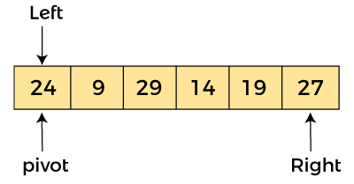
Quick Sort
5. end while
6. swap(a[lb],a[up])
7. return up
8. Stop
Let the elements of array are –
In the given array, we consider the leftmost element as pivot. So, in this case, a[left] = 24, a[right] = 27 and a[pivot] = 24.

Slide 80
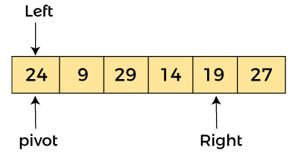
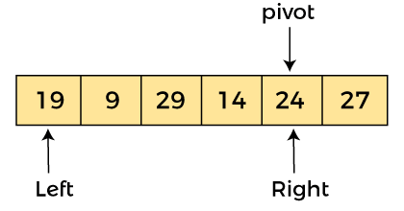
Quick Sort
Now, a[pivot] < a[right], so algorithm moves forward one position towards left, i.e. –
Now, a[left] = 24, a[right] = 19, and a[pivot] = 24.
Because, a[pivot] > a[right], so, algorithm will swap a[pivot] with a[right], and pivot moves to right, as –

Slide 81
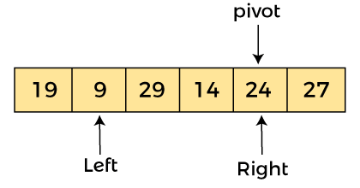
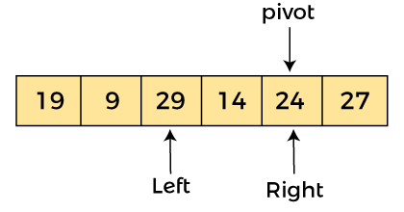
Quick Sort
Now, a[left] = 19, a[right] = 24, and a[pivot] = 24. Since, pivot is at right, so algorithm starts from left and moves to right.
As a[pivot] > a[left], so algorithm moves one position to right as –
Now, a[left] = 9, a[right] = 24, and a[pivot] = 24. As a[pivot] > a[left], so algorithm moves one position to right as –

Slide 82
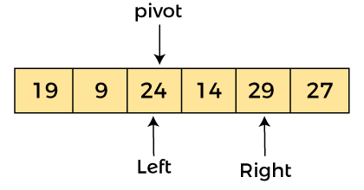
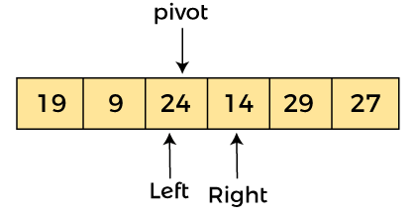
Quick Sort
Now, a[left] = 29, a[right] = 24, and a[pivot] = 24. As a[pivot] < a[left], so, swap a[pivot] and a[left], now pivot is at left, i.e.
Since, pivot is at left, so algorithm starts from right, and move to left. Now, a[left] = 24, a[right] = 29, and a[pivot] = 24. As a[pivot] < a[right], so algorithm moves one position to left, as –

Slide 83
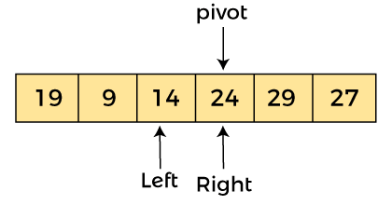
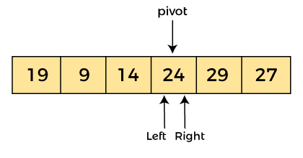
Quick Sort
Now, a[pivot] = 24, a[left] = 24, and a[right] = 14. As a[pivot] > a[right], so, swap a[pivot] and a[right], now pivot is at right, i.e. –
Now, a[pivot] = 24, a[left] = 14, and a[right] = 24. Pivot is at right, so the algorithm starts from left and move to right.

Slide 84
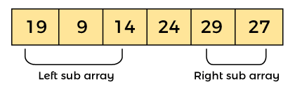
Quick Sort
Now, a[pivot] = 24, a[left] = 24, and a[right] = 24. So, pivot, left and right are pointing the same element. It represents the termination of procedure.
Element 24, which is the pivot element is placed at its exact position.
Elements that are right side of element 24 are greater than it, and the elements that are left side of element 24 are smaller than it.

Slide 85

Quick Sort
Now, in a similar manner, quick sort algorithm is separately applied to the left and right sub-arrays. After sorting gets done, the array will be –

Slide 86
Heap Sort
Heap sort processes the elements by creating the min-heap or max-heap using the elements of the given array.
Min-heap or max-heap represents the ordering of array in which the root element represents the minimum or maximum element of the array.
Heap sort basically recursively performs two main operations
Build a heap H, using the elements of array.
Repeatedly delete the root element of the heap formed in 1st phase.
Heap
A heap is a complete binary tree, and the binary tree is a tree in which the node can have the utmost two children.
A complete binary tree is a binary tree in which all the levels except the last level, i.e., leaf node, should be completely filled, and all the nodes should be left-justified.

Slide 87
Heap Sort
Algorithm
Heapify(A as array, n as int, i as int)
{
max = i
leftchild = 2i + 1
rightchild = 2i + 2
if (leftchild <= n) and (A[i] < A[leftchild])
max = leftchild
else
max = i
if (rightchild <= n) and (A[max] > A[rightchild])
max = rightchild
if (max != i)
swap(A[i], A[max])
Heapify(A, n, max)
}

Slide 88
Heap Sort
Heapsort(A as array)
{
n = length(A)
for i = n/2 downto 1
Heapify(A, n ,i)
for i = n downto 2
exchange A[1] with A[i]
A.heapsize = A.heapsize - 1
Heapify(A, i, 0)
}

Slide 89

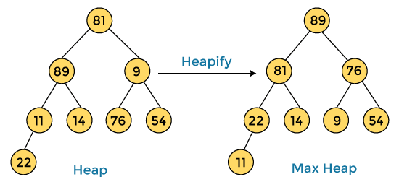
Heap Sort
Consider the array.
First, we have to construct a heap from the given array and convert it into max heap.

Slide 90

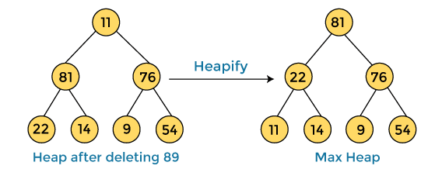
Heap Sort
After converting the given heap into max heap, the array elements are –
Next, we have to delete the root element (89) from the max heap.
To delete this node, we have to swap it with the last node, i.e. (11).
After deleting the root element, we again have to heapify it to convert it into max heap.

Slide 91

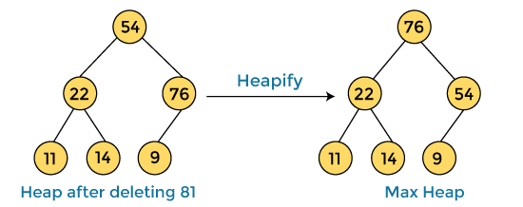
Heap Sort
After swapping the array element 89 with 11, and converting the heap into max-heap, the elements of array are –
In the next step, again, we have to delete the root element (81) from the max heap.
To delete this node, we have to swap it with the last node, i.e. (54).
After deleting the root element, we again have to heapify it to convert it into max heap.

Slide 92

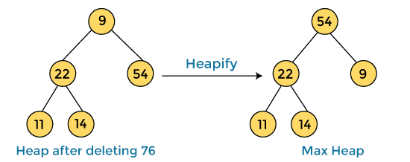
Heap Sort
After swapping the array element 81 with 54 and converting the heap into max-heap, the elements of array are –
In the next step, we have to delete the root element (76) from the max heap again.
To delete this node, we have to swap it with the last node, i.e. (9).
After deleting the root element, we again have to heapify it to convert it into max heap.

Slide 93

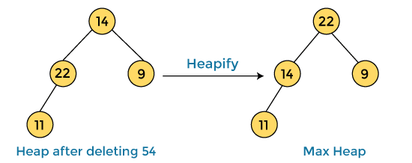
Heap Sort
After swapping the array element 76 with 9 and converting the heap into max-heap, the elements of array are –
In the next step, again we have to delete the root element (54) from the max heap.
To delete this node, we have to swap it with the last node, i.e. (14).
After deleting the root element, we again have to heapify it to convert it into max heap.

Slide 94

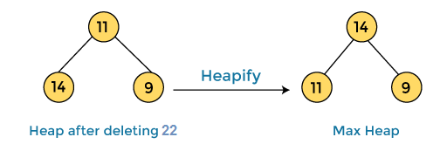
Heap Sort
After swapping the array element 54 with 14 and converting the heap into max-heap, the elements of array are –
In the next step, again we have to delete the root element (22) from the max heap.
To delete this node, we have to swap it with the last node, i.e. (11).
After deleting the root element, we again have to heapify it to convert it into max heap.

Slide 95

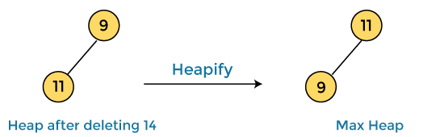
Heap Sort
After swapping the array element 22 with 11 and converting the heap into max-heap, the elements of array are –
In the next step, again we have to delete the root element (14) from the max heap.
To delete this node, we have to swap it with the last node, i.e. (9).
After deleting the root element, we again have to heapify it to convert it into max heap.

Slide 96

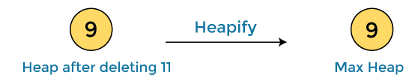

Heap Sort
After swapping the array element 14 with 9 and converting the heap into max-heap, the elements of array are –
In the next step, again we have to delete the root element (11) from the max heap.
To delete this node, we have to swap it with the last node, i.e. (9).
After deleting the root element, we again have to heapify it to convert it into max heap.

Slide 97
Searching
Searching: Searching is the technique of finding desired data items that has been stored within some data structure.
Data structures can include linked lists, arrays, search trees, hash tables, or various other storage methods.
Search algorithms can be classified based on their mechanism of searching. They are
Linear Search
Binary Search

Slide 98
Searching
Linear or Sequential searching
Linear Search is the most natural searching method and
It is very simple but very poor in performance at times
In this method, the searching begins with searching every element of the list till the required record is found.
The elements in the list may be in any order. i.e. sorted or
unsorted.
We begin search by comparing the first element of the list with the target element.
If it matches, the search ends and position of the element
is returned.
Otherwise, we will move to next element and compare. In this way, the target element is compared with all the elements until a match occurs.

Slide 99
Searching
If the match do not occur and there are no more elements to be compared, we conclude that target element is absent in the list by returning position as -1.
Algorithm for Linear search
Linear_Search (A[ ], N, val , pos )
Step 1 : Set pos = -1 and k = 0
Step 2 : Repeat while k < N
Begin
Step 3 : if A[ k ] = val
Set pos = k
print pos
Goto step 5
End while
Step 4 : print “Value is not present”
Step 5 : Exit

Slide 100
Searching
BINARY SEARCHING
Binary search is a fast search algorithm with run-time complexity of Ο(log n).
This search algorithm works on the principle of divide and conquer.
Binary search looks for a particular item by comparing the middle most item of the collection.
If a match occurs, then the index of item is returned.
If the middle item is greater than the item, then the item
is searched in the sub-array to the left of the middle item.
Otherwise, the item is searched for in the sub-array to the right of the middle item.
This process continues on the sub-array as well until the size of the sub array reduces to zero.

Slide 101
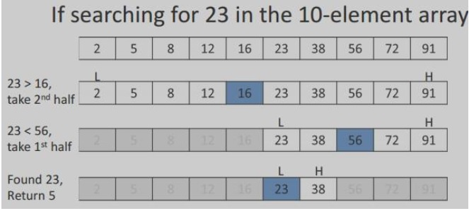
Searching
Before applying binary searching, the list of items should be sorted in ascending or descending order.

Slide 102
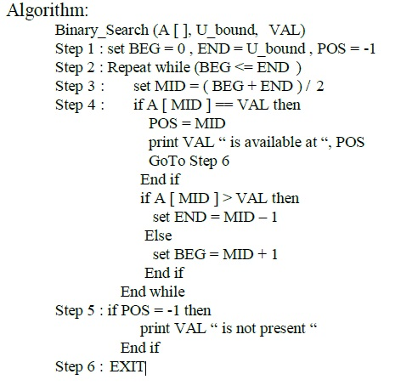
Searching

Slide 103
Radix Sort
Radix sort is the linear sorting algorithm that is used for integers.
In Radix sort, there is digit by digit sorting is performed that is started from the least significant digit to the most significant digit.
The process of radix sort works similar to the sorting of students names, according to the alphabetical order.
In this case, there are 26 radix formed due to the 26 alphabets in English.
In the first pass, the names of students are grouped according to the ascending order of the first letter of their names.
After that, in the second pass, their names are grouped according to the ascending order of the second letter of their name. And the process continues until we find the sorted list.

Slide 104
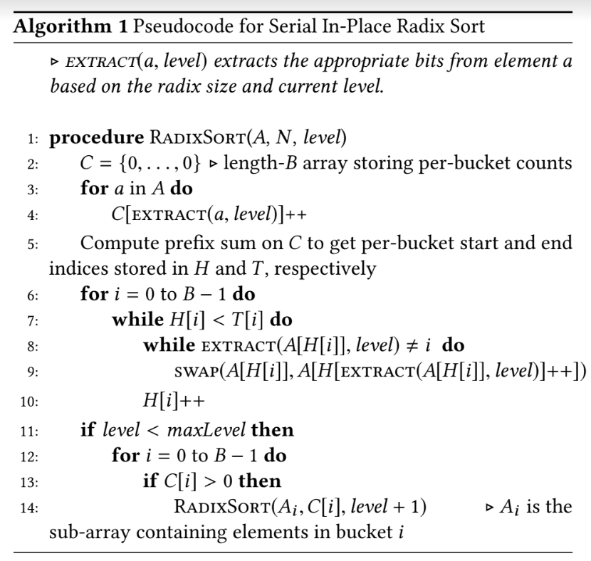
Radix Sort
Algorithm

Slide 105

Radix Sort
Working of Radix sort Algorithm
First, we have to find the largest element (suppose max) from the given array. Suppose 'x' be the number of digits in max.
The 'x' is calculated because we need to go through the significant places of all elements.
After that, go through one by one each significant place. Here, we have to use any stable sorting algorithm to sort the digits of each significant place.
In the given array, the largest element is 736 that have 3 digits in it. So, the loop will run up to three times (i.e., to the hundreds place).
That means three passes are required to sort the array.

Slide 106
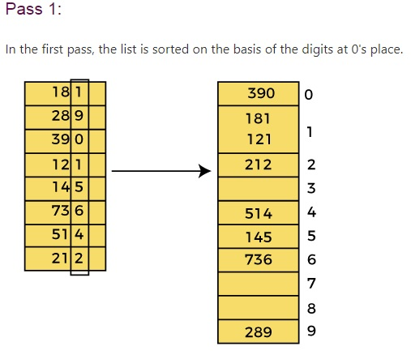
Radix Sort
Now, first sort the elements on the basis of unit place digits (i.e., x = 0). Here, we are using the counting sort algorithm to sort the elements.

Slide 107

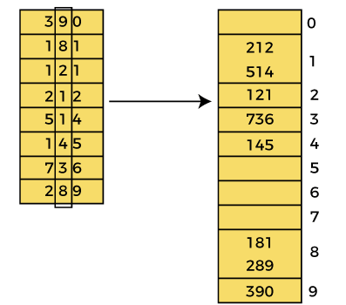
Radix Sort
After the first pass, the array elements are –
Pass 2:
In this pass, the list is sorted on the basis of the next significant digits (i.e., digits at 10th place).

Slide 108

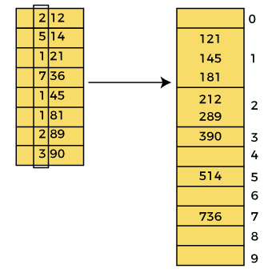
Radix Sort
After the second pass, the array elements are –
Pass 3:
In this pass, the list is sorted on the basis of the next significant digits (i.e., digits at 100th place).

Slide 109

Radix Sort
After the third pass, the array elements are –

Slide 110
HASH TABLE
Hash Table is a data structure which store data in associative manner.
In hash table, data is stored in array format where each data values has its own unique index value.
Access of data becomes very fast if we know the index of desired data.
Thus, it becomes a data structure in which insertion and search operations are very fast irrespective of size of data.
Hash Table uses array as a storage medium and uses hash technique to generate index where an element is to be inserted or to be located from.
Hashing
Hashing is a technique to convert a range of key values into a range of indexes of an array.
FACULTY OF
ENGINEERING
AND TECHNOLOGY

Slide 111
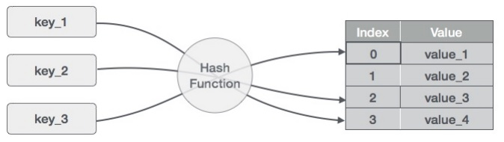
HASH TABLE
We're going to use modulo operator to get a range of key values.
Consider an example of hash table of size 20, and following items are to be stored. Item are in key, value format.
FACULTY OF
ENGINEERING
AND TECHNOLOGY

Slide 112
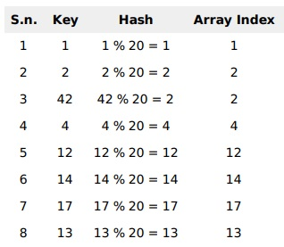

HASH TABLE
Linear Probing
It may happen that the hashing technique used create already used index of the array.
In such case, we can search the next empty location in the array by looking into the next cell until we found an empty cell.
This technique is called linear probing.
FACULTY OF
ENGINEERING
AND TECHNOLOGY

Slide 113
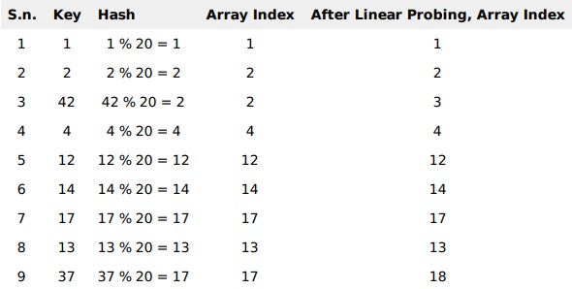
HASH TABLE
HASH FUNCTION
A hash function is an algorithm that converts a hash key to a hash value.
A good hash function is essential for the effective performance of the hash table.
FACULTY OF
ENGINEERING
AND TECHNOLOGY

Slide 114
HASH TABLE
The main requirements of a hash function are that it must:
always produce the same hash value for the same key.
provide a uniform distribution of hash values. This means that every value has an equal probability of being generated.
minimise clustering; this will arise when many different keys produce the same hash value. Where two or more different keys produce the same hash value, we say a ‘collision’ has occured.
be very fast to compute.
FACULTY OF
ENGINEERING
AND TECHNOLOGY

Slide 115
HASH TABLE
A simple hash function
Let's take a look at a simple hash function. Here we will assume that the keys are 5 digit numbers and we have a hash table with 97 buckets.
FUNCTION hash_integer(hash_key, number_of_slots)
// Generate the hash value using the modulo operator
hash_value = hash_key MOD number_of_slots
// Return the hash value
RETURN hash_value
ENDFUNCTION
FACULTY OF
ENGINEERING
AND TECHNOLOGY

Slide 116
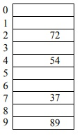
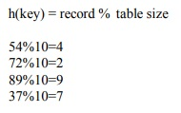
HASH TABLE
TYPES OF HASH FUNCTION
1. Division Method:
The hash function depends upon the remainder of division. Typically the divisor is table length.
For eg; If the record 54, 72, 89, 37 is placed in the hash table and if the table size is 10 then
FACULTY OF
ENGINEERING
AND TECHNOLOGY

Slide 117
HASH TABLE
TYPES OF HASH FUNCTION
2. Mid Square:
In the mid square method, the key is squared and the middle or mid part of the result is used as the index.
If the key is a string, it has to be preprocessed to produce a number.
Consider that if we want to place a record 3111 then
(3111) squre = 9678321
for the hash table of size 1000
H(3111) = 783 (the middle 3 digits)
FACULTY OF
ENGINEERING
AND TECHNOLOGY

Slide 118
HASH TABLE
TYPES OF HASH FUNCTION
3. Digit Folding:
The key is divided into separate parts and using some simple operation these parts are combined to produce the hash key
For eg; consider a record 12365412 then it is divided into separate parts as 123 654 12 and these are added together
H(key) = 123+654+12 = 789
The record will be placed at location 789
FACULTY OF
ENGINEERING
AND TECHNOLOGY

Slide 119
HASH TABLE
COLLISION
The hash function is a function that returns the key value using which the record can be placed in the hash table.
Thus this function helps us in placing the record in the hash table at appropriate position and due to this we can retrieve the record directly from that location.
This function need to be designed very carefully and it should not return the same hash key address for two different records.
This is an undesirable situation in hashing.
Similarly when there is no room for a new pair in the hash table then such a situation is called overflow.
Collision and overflow show the poor hash functions.
FACULTY OF
ENGINEERING
AND TECHNOLOGY

Slide 120
HASH TABLE
COLLISION RESOLUTION TECHNIQUES
If collision occurs then it should be handled by applying some techniques.
Such a technique is called collision handling technique.
1.Chaining
2.Open addressing (linear probing)
3.Quadratic probing
4.Double hashing
5.Rehashing
FACULTY OF
ENGINEERING
AND TECHNOLOGY

Slide 121
HASH TABLE
COLLISION RESOLUTION TECHNIQUES
CHAINING
In collision handling method chaining is a concept which introduces an additional field with data i.e. chain.
A separate chain table is maintained for colliding data. When collision occurs then a linked list(chain) is maintained at the home bucket.
For eg; Consider the keys to be placed in their home buckets are 131, 3, 4, 21, 61, 7, 97, 8, 9
then we will apply a hash function as H(key) = key % D
Where D is the size of table. The hash table will beHere D = 10
FACULTY OF
ENGINEERING
AND TECHNOLOGY

Slide 122
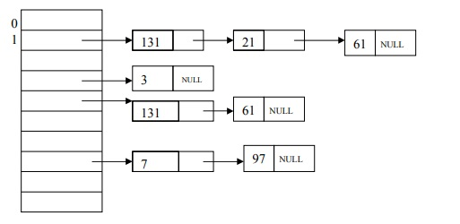
HASH TABLE
COLLISION RESOLUTION TECHNIQUES
CHAINING
FACULTY OF
ENGINEERING
AND TECHNOLOGY

Slide 123
HASH TABLE
COLLISION RESOLUTION TECHNIQUES
Linear Probing
It may happen that the hashing technique used create already used index of the array.
In such case, we can search the next empty location in the array by looking into the next cell until we found an empty cell.
This technique is called linear probing.
FACULTY OF
ENGINEERING
AND TECHNOLOGY

Slide 124
String Matching Algorithms
String matching operation is a core part in many text processing applications.
The objective of this algorithm is to find pattern P from given text T.
Typically |P|<< |T|.
In the design of compilers and text editors, string matching operation is crucial.
So locating P in T efficiently is very important.
The problem is defined as follows: “Given some text string T[1….n] of size n, find all occurrences of pattern P[1…m] of size m in T.”
FACULTY OF
ENGINEERING
AND TECHNOLOGY

Slide 125
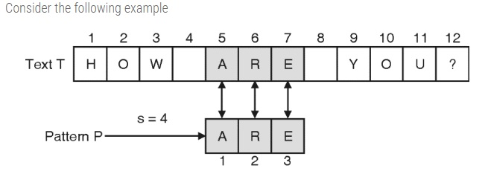
String Matching Algorithms
In this example, pattern P = ARE is found in text T after four shifts.
The classical application of such algorithms are to find particular protein pattern in DNA sequence.
FACULTY OF
ENGINEERING
AND TECHNOLOGY

Slide 126
String Matching Algorithms
Naive String Matching Algorithm
Working Mechanism
This is simple and efficient brute force approach.
It compares the first character of pattern with searchable text. If a match is found, pointers in both strings are advanced.
If a match is not found, the pointer to text is incremented and pointer of the pattern is reset.
This process is repeated till the end of the text.
The naïve approach does not require any pre-processing. Given text T and pattern P, it directly starts comparing both strings character by character.
After each comparison, it shifts pattern string one position to the right.
FACULTY OF
ENGINEERING
AND TECHNOLOGY

Slide 127
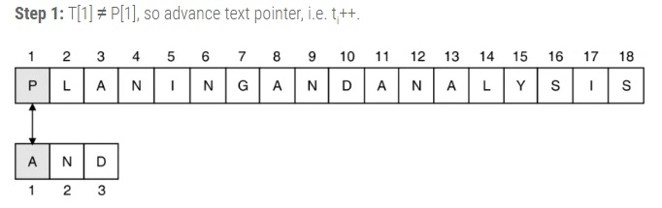
String Matching Algorithms
Following example illustrates the working of naïve string matching algorithm. Here, T = PLANINGANDANALYASIS and P = AND
Here, t_{i} and p_{j} are indices of text and pattern respectively.
FACULTY OF
ENGINEERING
AND TECHNOLOGY

Slide 128
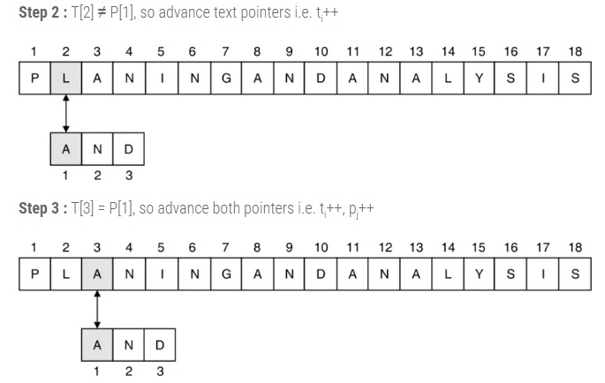
String Matching Algorithms
FACULTY OF
ENGINEERING
AND TECHNOLOGY

Slide 129
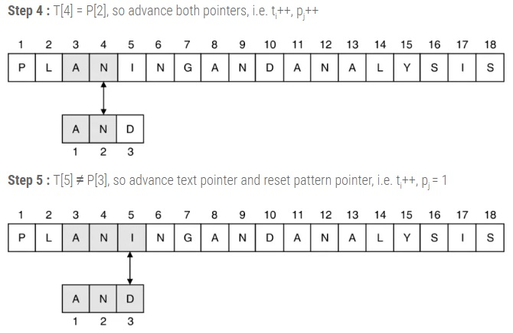
String Matching Algorithms
FACULTY OF
ENGINEERING
AND TECHNOLOGY

Slide 130
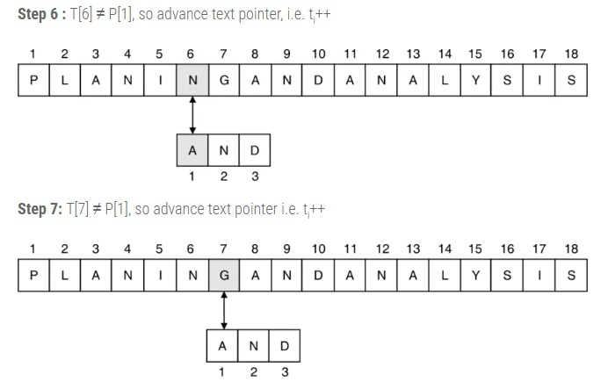
String Matching Algorithms
FACULTY OF
ENGINEERING
AND TECHNOLOGY

Slide 131
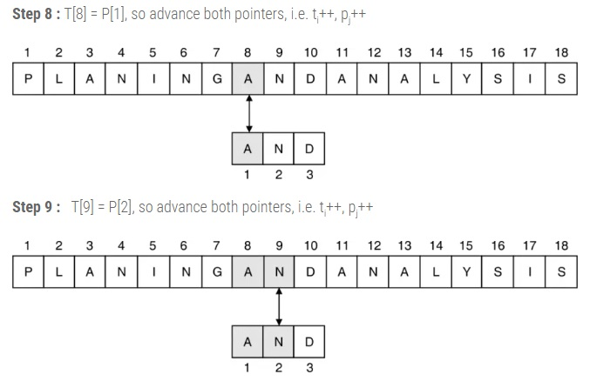
String Matching Algorithms
FACULTY OF
ENGINEERING
AND TECHNOLOGY

Slide 132
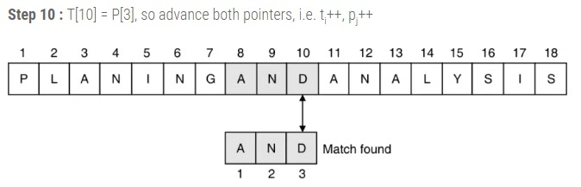
String Matching Algorithms
This process continues till the possible comparison in the text string.
FACULTY OF
ENGINEERING
AND TECHNOLOGY

